Slide 1
Introductory Presentation
Team Name:

Slide 2

Management Structure
Mechanical | Electrical | Software
Aadam Iftikhar | Thomas Gaertner | Daniel Rivlin
Gabriel Bednarkiewicz | Andrew Farquharson | Eduard Burlacu
*It is important to note that these are loose descriptions, with member reassigned to various roles as the project requires, further details on following page.

Slide 3
Timetable of Roles
Members | Week 1 | Week 2 | Week 3 | Week 4
Daniel Rivlin | Mechanical | Mech/Soft | Software | Debugging
Eduard Burlacu | Mechanical | Mech/Soft | Software | Debugging
Thomas Gaertner | Electronics | Electronics | Electronics | Troubleshooting
Andrew Farquharson | Electronics | Electronics | Electronics | Troubleshooting
Aadam Iftikhar | Mechanical | Mechanical | Elec/Mech | Troubleshooting
Gabriel Bednarkiewicz | Mechanical | Mechanical | Elec/Mech | Troubleshooting

Slide 4

THE PROBLEM
Navigate from start point to end point and back
Drivetrain and navigation system required
Passing through tunnel and over ramp, adds additional constraints
Collect a block from designated point
Lift block 100mm onto truck

Slide 5

SOLUTIONS
Navigation: Line-following (possible compass or computer vision as redundancies)
Drivetrain: Two rear wheels, ball bearing at the front, allows for turning on the spot.
Block Collection: claw powered by servo motor
Block Elevation: Use claw attached to spinning threaded rod (smooth rod and linear bearing used for stabilization)

Slide 6
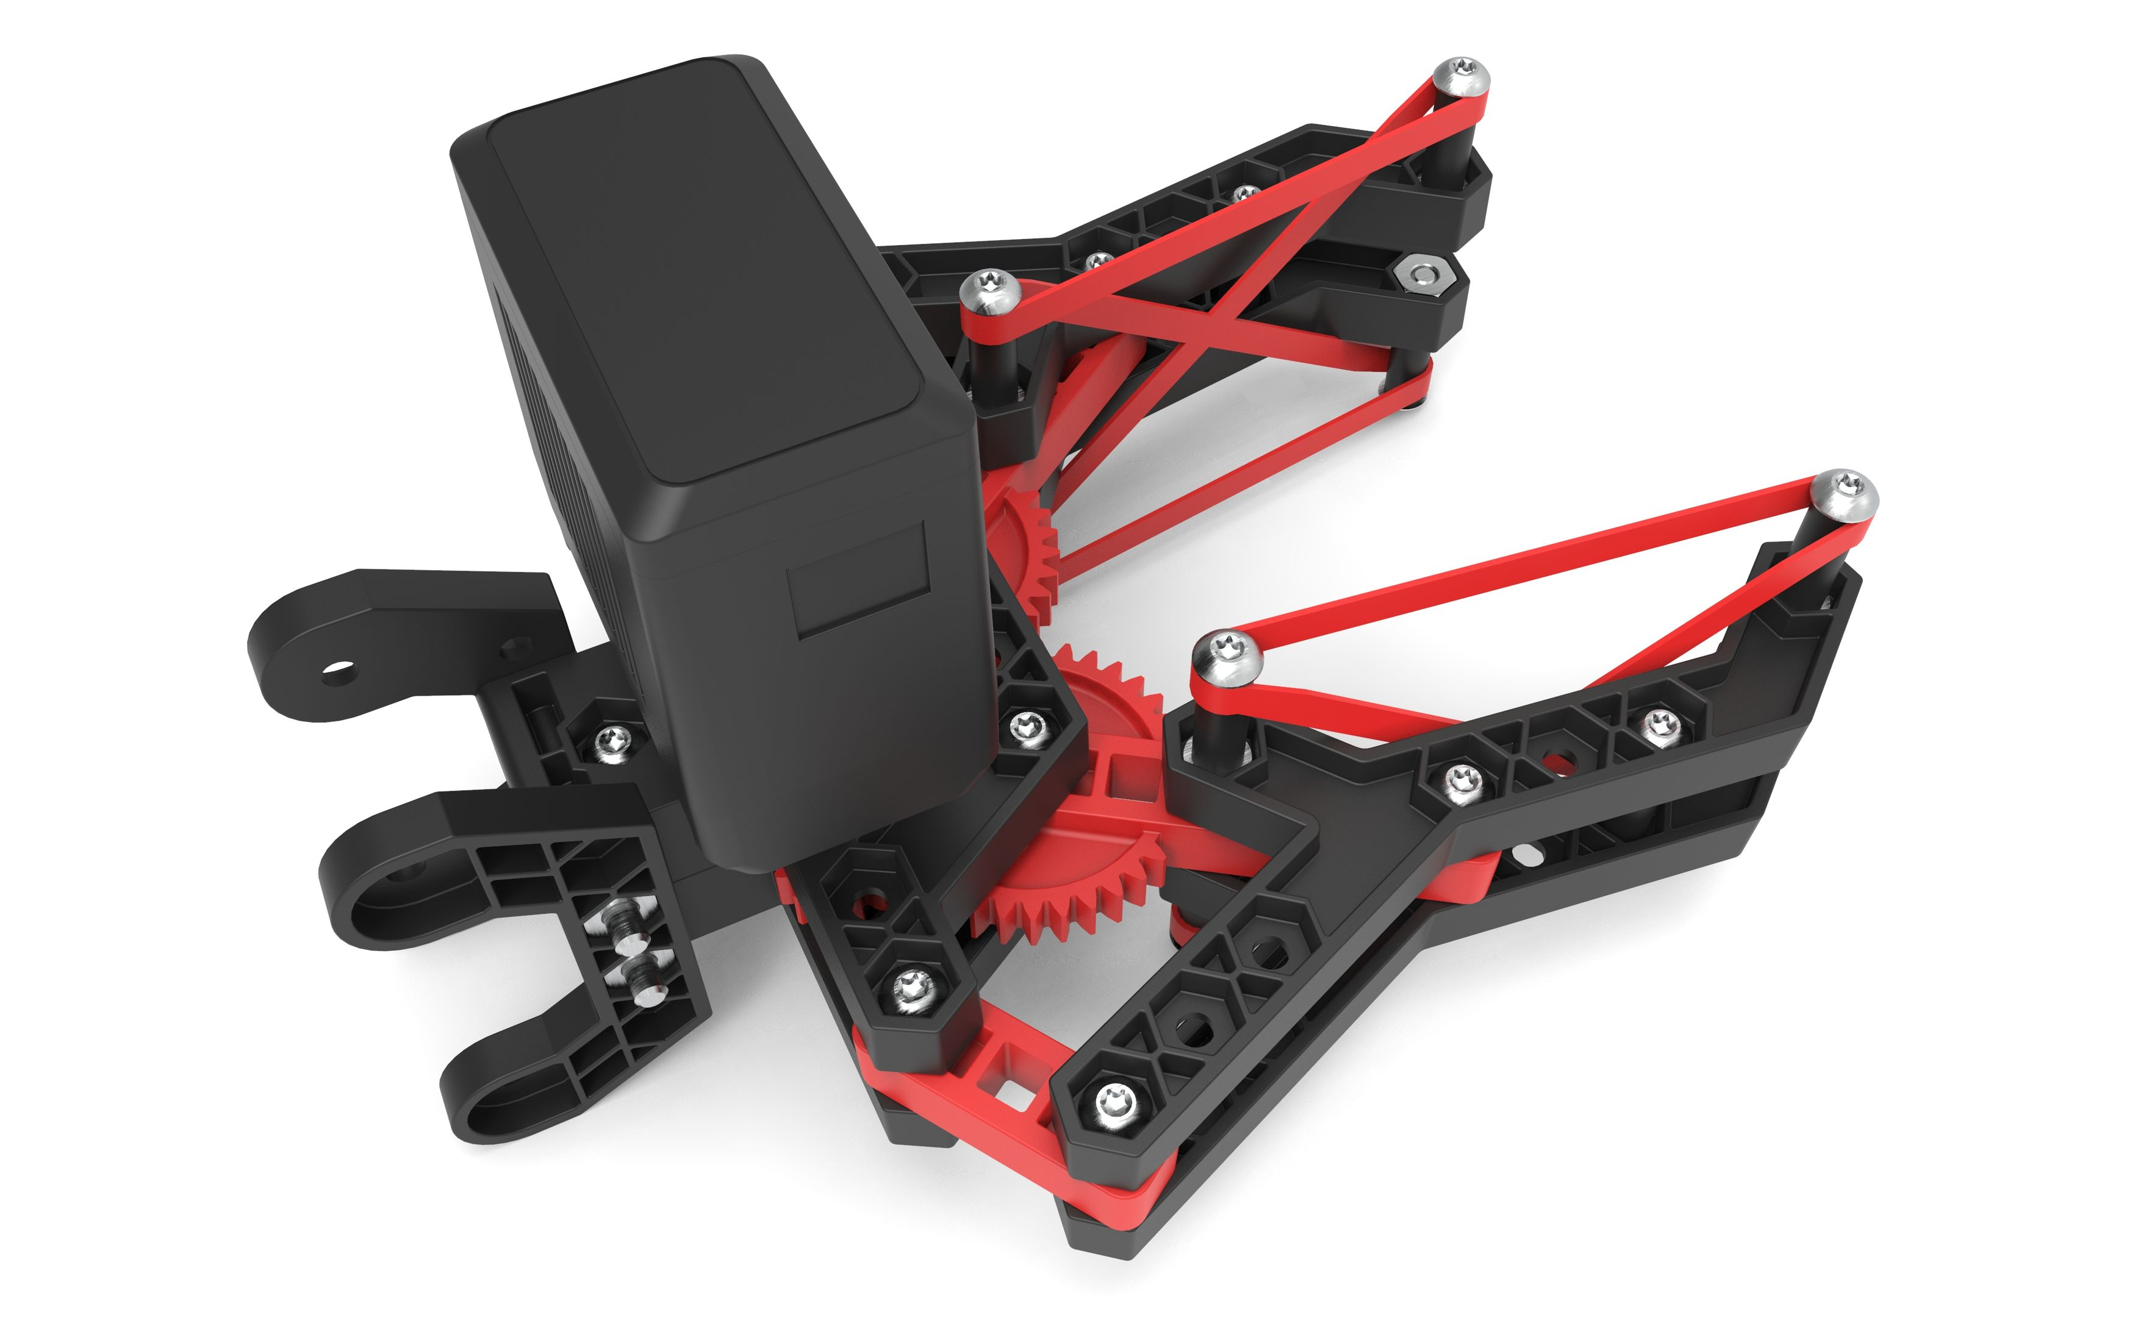
Limitations
Tunnel does not have line, accurate orientation and travel distance measurement required, limit switches as possible redundancies
Enough torque to climb ramp is required
Stalling servo motor is a risk, use of rubber bands to increase friction and prevent stalling
For lifting mechanism: height of tunnel and complexity of design may increase fabrication time, claw with attached motor is heavy
Minimum clearance to ascend ramp required
Tunnel width limits size.

Slide 7

ANY QUESTIONS?

